Slide 1

Seminar Report
University Dashboard by Power BI
Name: Surya deep Das
Enroll: MS19GCS059

Slide 2

Acknowledgement
I would like to express my heartfelt gratitude and extend my sincere acknowledgement to Sir Debasish for his exceptional guidance and mentorship. His extensive knowledge and expertise un the field have been instrumental in shaping my understanding and growth.
Secondly, I would like to acknowledge Sir Supratik for his invaluable support and encouragement throughout my journey. His profound insights and unique perspectives have challenged and inspired me to push beyond the limits. His unwavering belief in my abilities has been a constant source of motivation for me.
Lastly, I would like extend my appreciation to the CIC team. They played a pivotal role in upholding the principles of transparency and accountability and their commitment to ensuring access to information has been commendable
In conclusion, I am deeply indebted to Sir Debasish, Sir Supratik, and the CIC for their invaluable contributions, guidance, and support. Their mentorship and expertise have played an instrumental role in shaping my personal and professional development. I am truly grateful for their unwavering support, and I will carry the lessons I have learned from them throughout my life and career.

Slide 3
Index
Contents | Page No.
About NIIT UNIVERSITY | 4
Tech Stack Requirements | 5
Deliverables | 6
KPI (Key Performance Indicators) | 8
Benefits | 9
Value added to University | 10
Future Scope | 11
Timeline | 12

Slide 4
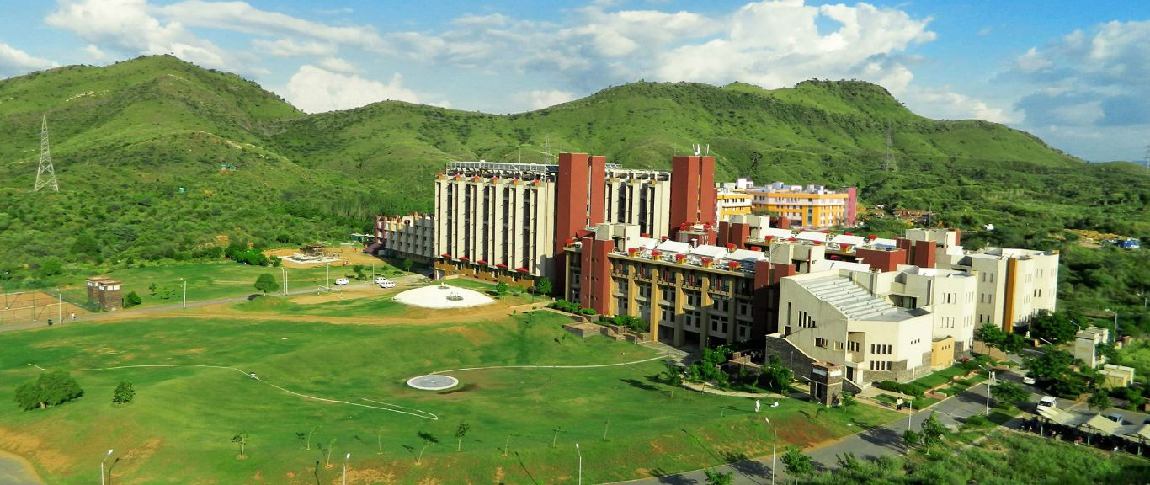
About NIIT University
NIIT, formerly known as the National Institute of Information Technology, is a global skills and talent development company. It was founded in 1981 in India and has since expanded its operations to several countries worldwide.
NIIT offers a wide range of training and educational programs in various fields, including information technology, digital marketing, banking, finance, and management. The company focuses on providing industry-relevant skills and transforming individuals into competent professionals. The training programs are designed to cater to different segments of learners, including individuals, corporations, and institutions. They offer courses and certifications at various levels, from foundational to advanced, to meet the diverse needs of learners. In addition to its training programs, NIIT also provides learning solutions and services to businesses and institutions. This includes corporate training, learning management systems, and other customized learning solutions to help organizations enhance their workforce capabilities.
Over the years, NIIT has established partnerships with leading technology companies, academic institutions, and government organizations to deliver high-quality training and education. These collaborations enable NIIT to stay updated with the latest industry trends and offer relevant programs that align with market demands. It's worth noting that while this information is accurate as of my knowledge cutoff in September 2021, please visit NIIT's official website or contact them directly for the most up-to-date and detailed information about their programs and services.

Slide 5



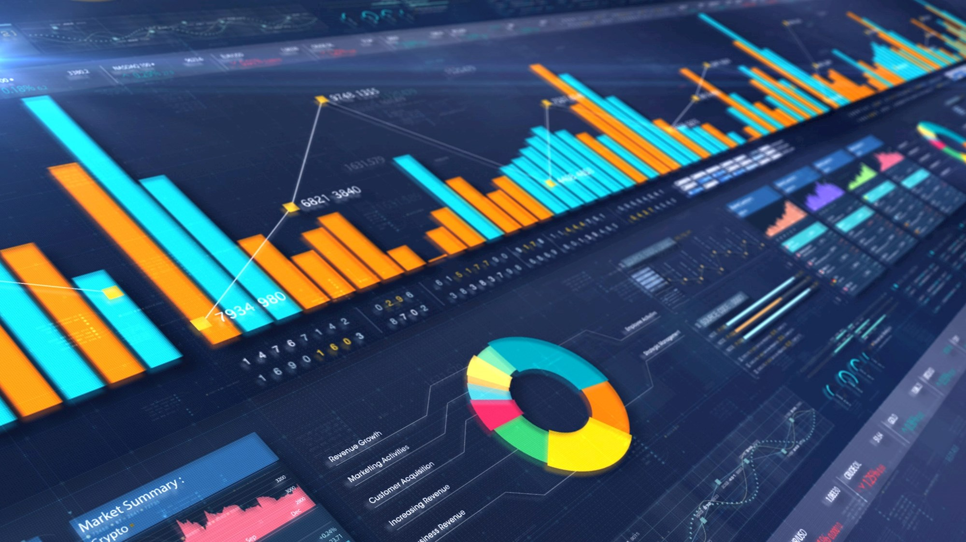

Tech Stack Requirements
Excel
PowerBI
Data
SQL

Slide 6
Deliverables
Data
Reports
Gauge Chart
Stacked Bar Chart

Slide 7
Deliverables Cont.…
Pie Chart
Decomposition Tree
Ribbon Chart
Map(Filled Map or Bubble map)

Slide 8
Key Performance Indicators
Gauge Chart
Pie Chart
Decomposition Tree
Bar & Column Chart
Ribbon Chart
Map( Filled Map or Bubble chart)
Applied to make a data hierarchy and difference step wise
Applied for colourful patterns & visualization of multiple data
Applied for analysing CGPA
Applied to highlight various patterns
Applied for primary analysis & visualization of data
Applied for the prediction of location

Slide 9
Benefits
Enables real-time analysis with quick navigation
Improves decision making
Reports can be accessed across multiple platforms
Access to real-time information
Personalized dashboards

Slide 10
Value added to University
Enhanced Data Visibility
The University Dashboard can provide a centralized data and real time view of critical data such as academic performance, faculty workload, financials and resource allocation.
Data Driven Decision Making
With access to comprehensive data and analytics through the university dashboard, administrators, faculty and staff can make data-driven decisions.
Performance Monitoring
Proactive Intervention and Support
The availability of timely data and analytics can enable the identification of at-risk students or areas that require attention.
Institution Accountability and Accreditation
It can help demonstrate compliance with standards, benchmarks, and performance metrics set by accrediting bodies, thereby enhancing the reputation and credibility of the institution.
Stakeholder Engagement
The University Dashboard can facilitate better communication and engagement with various stakeholders, including parents, faculty and alumni.
The dashboard can enable monitoring and evaluation of various performance indicators such as student retention, graduation rates, faculty productivity and research output.

Slide 11
Future Scope
Advanced Analytics & Predictive Modeling
University Dashboard can incorporate advanced analytic techniques and predictive modelling to generate valuable insights
AI & ML systems
Mobile & Cloud Based Access
Integration of Alumni and Employer data
With the integration of artificial intelligence(AI) & machine learning algorithms(ML), future University Dashboards can track individual progress & suggest tailored content.
Cloud Based infrastructure can enable seamless collaboration and data sharing across different devices and locations
Future university dashboards can integrate alumni and employer data to track graduate outcomes, career progression and industry trends.

Slide 12
Timeline (Feb,2023 to June,2023)
June
CIC Group discussion
Given Data set
Created wireframe model & demo charts
May
Submitted Technical report
Learning SQL, Power BI & software skills
Software Handling perceptions
April
Submitted workplan
Understood the importance of project
Started gaining technical knowledge requirements
February
March
Seminar Report Submission
Started Project on 5th Feb, 2023
Submitted KYO report

Slide 13
Video Presentation
The link of the video presentation is provided below with the help of Google Drive link:
https://drive.google.com/file/d/1Q3FbrwZmac_aI8EP6w4qH-dNGggYfOfV/view?usp=sharing

Slide 14

Thank You

